Slide 1

APEX INSTITUTE OF TECHNOLOGY
DEPARTMENT OF COMPUTER SCIENCE & ENGINEERING
Agile Practices (22CSH-292)
Faculty: Mamta Sharma(E15565)
Lecture1.1: Agile Development
DISCOVER . LEARN . EMPOWER

Slide 2
Learning Outcome of this lecture
CO1 | Understand the Agile Methodology and comparing various other software development models with agile.
CO2 | Examine Scrum and test driven development
CO3 | Apply the various tools available to agile teams to facilitate the project
CO4 | Analyze the method to improve results for a specific circumstance
CO5 | Evaluate likely successes and formulate plans to manage likely risks or problems

Slide 3
Learning Outcome of this lecture
Unit | Name | Outcome
I | Understanding common Agile Practices in DevOps | Introduction to Product Management, Product Design and Requirement gathering, Product Design Challenges, UX Design, Product Development Methodologies, Product Marketing and Presentation, Traditional Software Development Methodologies, Problem/issues with traditional approach, Agile Development, Agile Manifesto, Scrum Model, Agile Estimations and Planning, Soft skills in agile
CO 1 Apply the Agile Methodology and comparing various other software development models with agile
T

Slide 4
Outline
What is Design Thinking?
When to use Design Thinking?
Importance of Design Thinking
Benefits of Design Thinking
References

Slide 5
What is Design Thinking
Design Thinking is both an ideology and a process, focused on resolving complex problems in a highly user-centric way.
It is an approach used for practical and creative problem-solving. It is based heavily on the methods and processes that designers use, but it has evolved from a range of different fields — including architecture, engineering and business.
Design Thinking focuses on humans first, seeking to understand people’s needs and come up with effective solutions to meet their needs. It is what we call a solution-based approach to problem-solving.

Slide 6
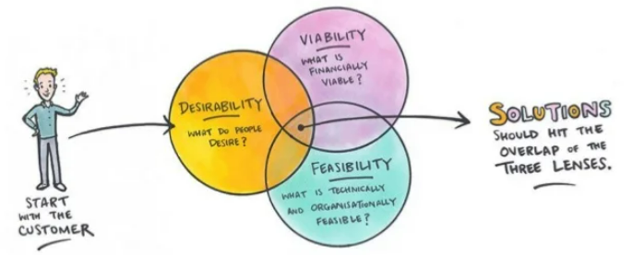

Slide 7
What is Design Thinking
Design thinking focuses on human First, seeking to understand human needs.
It investigates human needs while studying feasibility and economics.
Design Thinking is:
• Iterative
• Democratic
• Collaborative
• Inclusive
• Interdisciplinary

Slide 8
When to use design thinking
• Design products or services with people's needs in mind
• Introduce empathy into problem-solving
• Prototype ideas early and gather feedback
• Collaborate with others to unravel complex problems

Slide 9
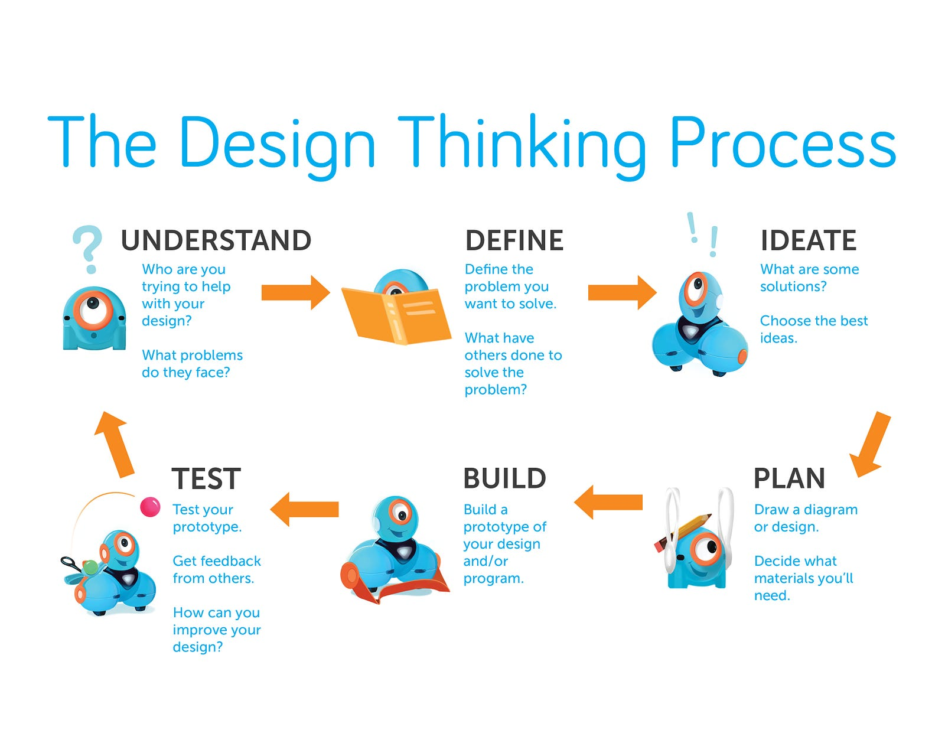

Slide 10
When to use design thinking
Now, let's understand design thinking with a classroom example.
Problem statement:
How would you redesign a classroom to meet students’ needs?
Solution:
Ms. Monica is the class teacher for 1st-grade, and she prefers to talk to students directly and figure out the best interior design for the environment (classroom).
After discussing with the students, she implemented the technique of design thinking.
However, she got excellent results, which are:
Students liked to stay in the classroom
The students showed wonderful improvement in terms of interaction with the teacher
Students could move freely in the classroom
During class hours, they showed more interest in learning
Isn't it great? Of course, it is!
Next comes the important topic, the Design thinking process.

Slide 11
Importance of Design Thinking
The main objective is to solve the customer’s requirements
Helps in tackling ambiguous and challenging problems
Drives people to create innovative solutions
It helps organisations to run faster with more efficiency

Slide 12
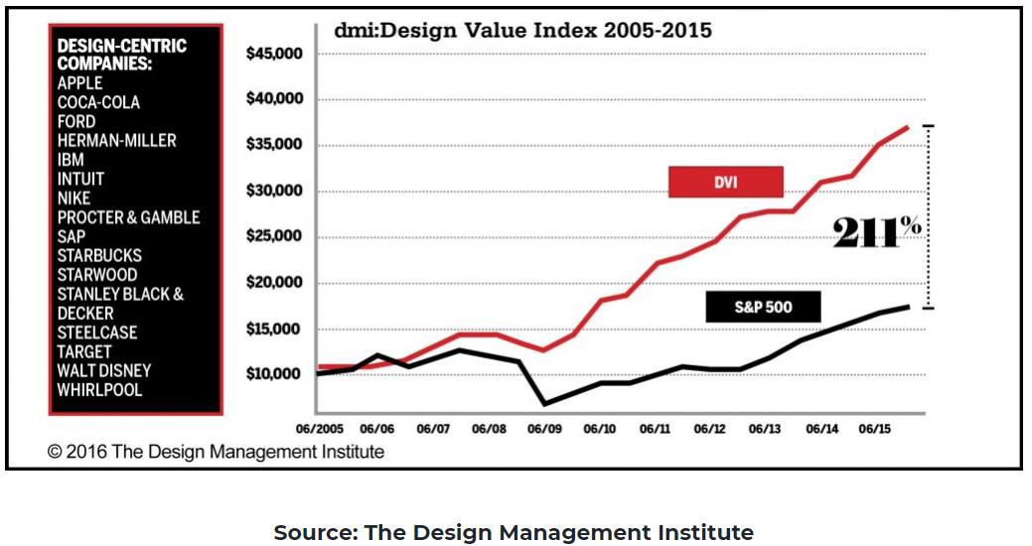
Importance of Design Thinking
The chart displayed below indicates that the design-centric companies have outperformed the S&P 500 by a massive 211%.

Slide 13
Benefits of Design Thinking
It helps to overcome the creative challenges: Design Thinking provides you with the freedom to have a look at problems from several perspectives. It involves a lot of brainwork to bring out the best ideas, which helps broaden the learner’s knowledge.
It helps to effectively meet the customers’ requirements: As we discussed earlier, design thinking involves developing prototypes where you perform testing and implement the customer’s feedback iteratively for quality assurance. By following the design thinking approach effectively, your product will eventually meet the customers’ requirements.
It helps broaden your knowledge of Design Thinking: You will perform numerous evaluations in the design thinking process. You will always try to improvise your model by implementing the customer’s feedback to ensure that the customer is satisfied.

Slide 14
Text Books and Reference Books
T1 Agile Project Management with Kanban - Book by Eric Brechner
T2 Agile Foundations: Principles, Practices and Frameworks – Peter Measey
Reference Books:
1 Agile Project Management with Kanban Eric Brechner 2nd Microsoft Press 2021
2 Agile Foundations Peter Measey(4th BCS,) The Chartered Institute for IT 2015

Slide 15
References
https://www.mygreatlearning.com/blog/importance-of-design-thinking/
https://www.interaction-design.org/literature/article/5-stages-in-the-design-thinking-process
https://en.wikipedia.org/wiki/Design_thinking

Slide 16
THANK YOU
For queries
Email: mamta .e15565@cumail.in

